Slide 1
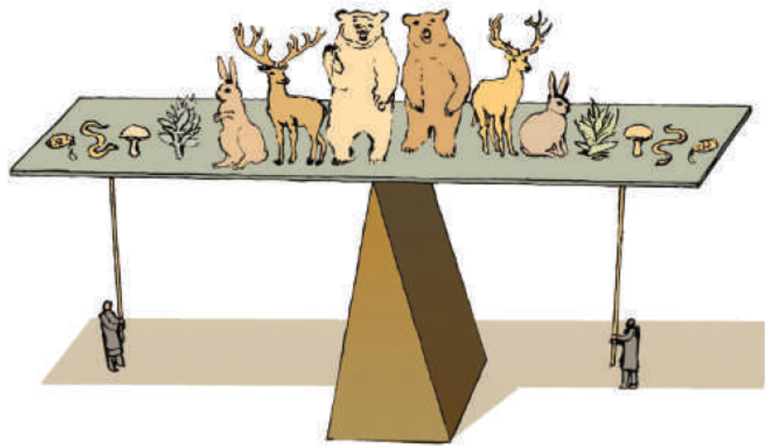
Ecosystem Functioning

Slide 2
Richness
Ecosystem
Functioning
Abundance
Body mass
Notes:
Up to this point, we have discused spatial patterns in richness, abundance, and body mass. WE have also seen that these different patterns are related to each other. The extent to which one influences the others is matter of debate, however, their ointeractions within any given community is what is refered as the fucntiuoing of the ecosystems

Slide 3
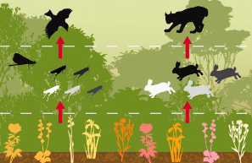
How is ecosystem functioning measured?
Ecosystem functioning: Efficiency with which energy fluxes through an environment
BIOMASS
Secondary production
Primary
production
Nutrient
cycling
Decomposition

Slide 4
The main focus of attention has been on how functioning relates to biodiversity
Some math background
Y=a*X^{^b}
, the so called power model
b >1
b =1
y
b <1
x

Slide 5
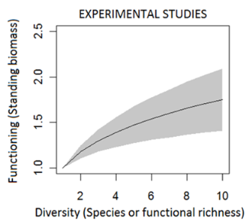
The main focus of attention has been on how functioning relates to biodiversity
From 111 experimental studies, the slope of the power model (b) was 0.15 to 0.32
(Cardinale et al. Nature 2006)

Slide 6
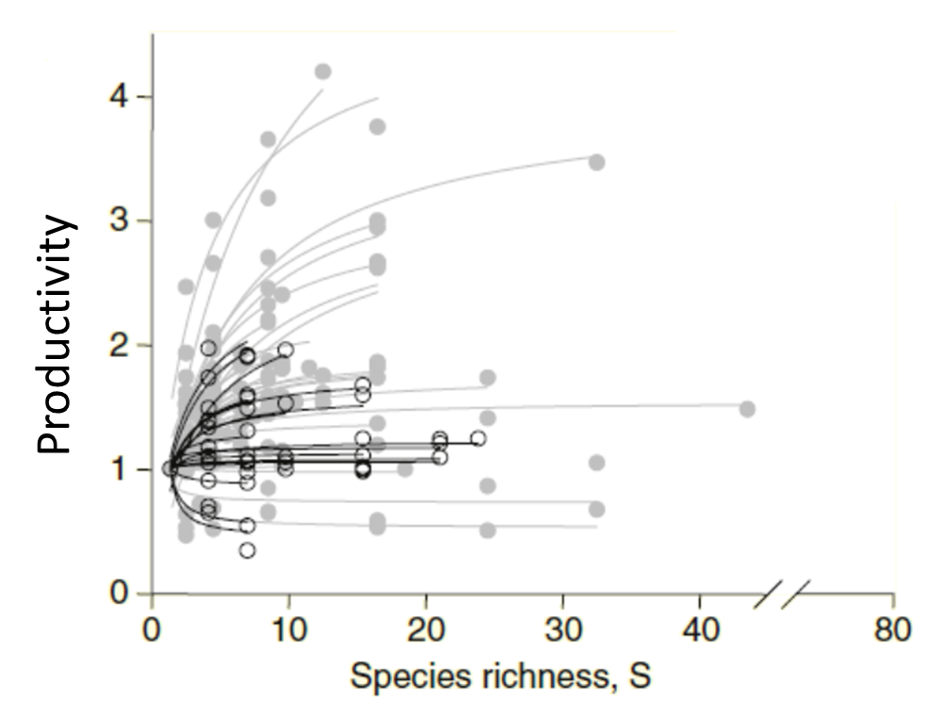
The main focus of attention has been on how functioning relates to biodiversity
Loreau

Slide 7
Why functioning increases with increases in biodiversity?
More traits
More functions
Complementarity
Species pool
More species
Sampling effect
Higher chances of getting highly productive species
Loreau et al. Nature 2001
Notes:
Fig. 2. Hypothesized mechanisms
involved in biodiversity
experiments using synthetic
communities. Sampling effects
are involved in community assembly,
such that communities
that have more species
have a greater probability of
containing a higher phenotypic
trait diversity. Phenotypic
diversity then maps
onto ecosystem processes
through two main mechanisms:
dominance of species
with particular traits, and
complementarity among species
with different traits. Intermediate
scenarios involve
complementarity among particular
species or functional
groups or, equivalently, dominance
of particular subsets
of complementary species.

Slide 8
What factors influence the relationship functioning versus diversity?
What are some of the reasons for such variability?

Slide 9
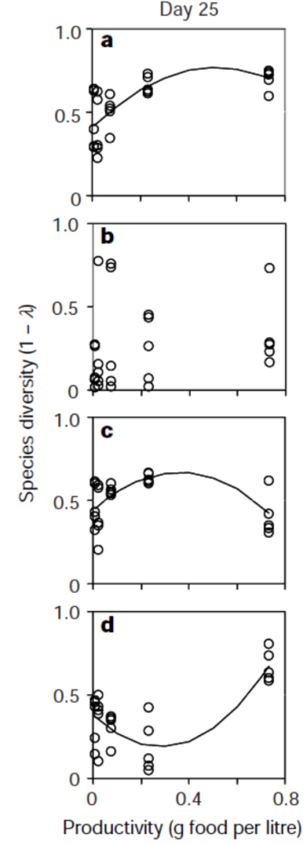
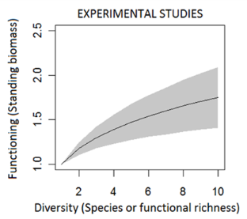
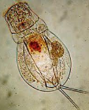
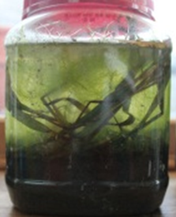
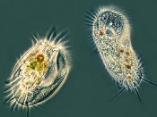
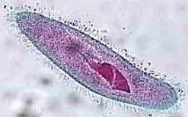
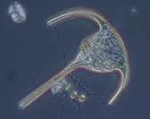
What factors influence the relationship functioning versus diversity?
History of colonization
Rotifers
Protozoans
Order of appearance
Ciliates
Microflagellates
Fukami & Morin Nature 2003
Notes:
Given differential extinction under disturbances, producers increase their biomass production under warming environmentas but overall prodcutivity often declines in the same warming conditions

Slide 10
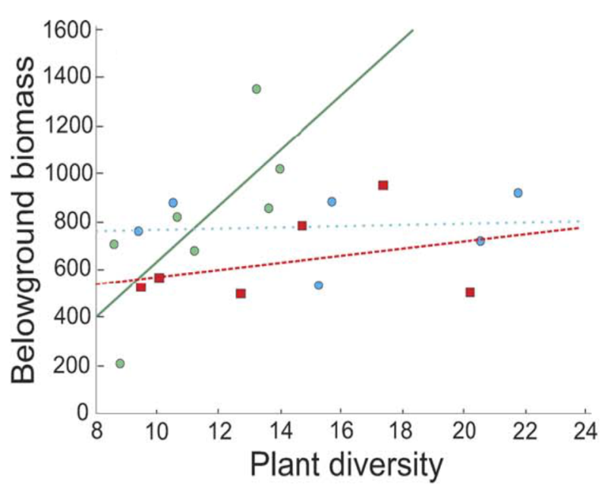
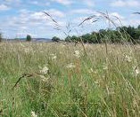
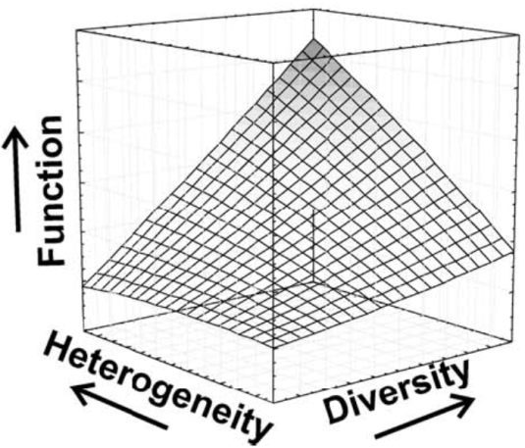
What factors influence the relationship functioning versus diversity?
Habitat heterogeneity
Semi-natural grasslands
High soil heterogeneity
Given the same diversity you get more functioning in more heterogeneous habitats
Low soil heterogeneity
Medium soil heterogeneity
Why?
Tylianakis et al. PlosBiology 2009

Slide 11
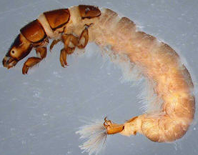
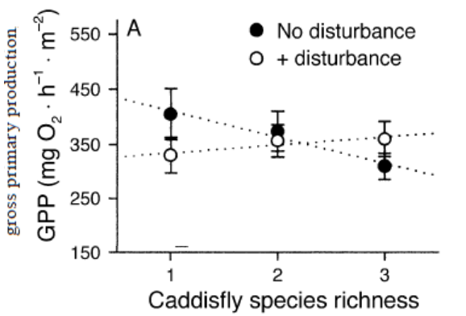
What factors influence the relationship functioning versus diversity?
Disturbances
Caddisflies
The absence of disturbance led to dominance by a competitively superior species
Why?
Cardinale & Palmer Ecology 2002

Slide 12
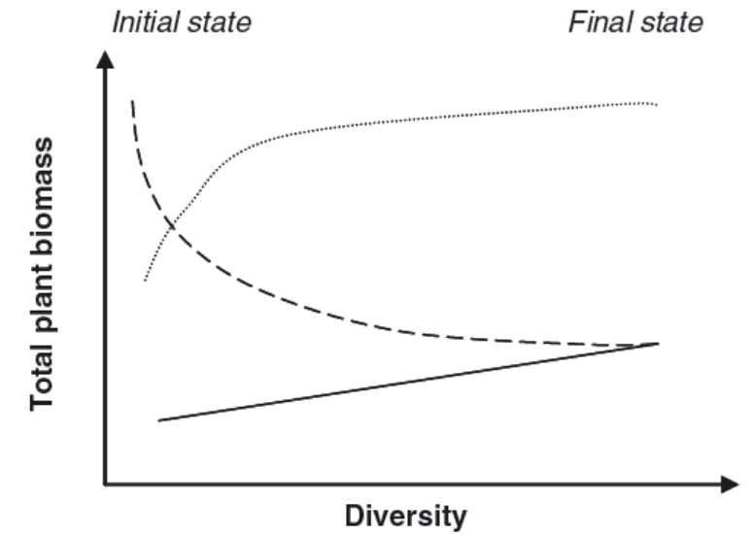
What factors influence the relationship functioning versus diversity?
Ecological interactions
Plant diversity alone in the absence of herbivores
herbivores diversity alone
Why?
Plants and herbivores diversity
Duffy et al. Ecology Letters 2007

Slide 13
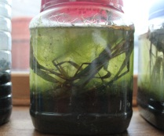
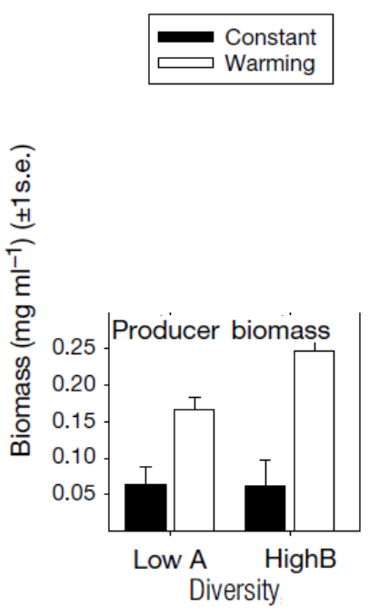
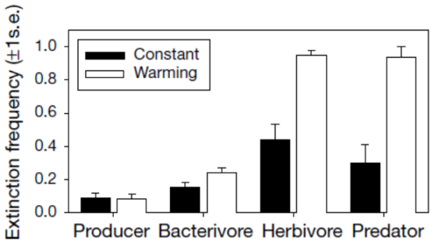
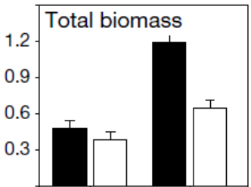
What factors influence the relationship functioning versus diversity?
Disturbances in interaction with trophic roles
Very simplistic
Warming kills herbivores and predators more so than producers and bacterivores
Petchey et al. Nature 1999
Notes:
Given differential extinction under disturbances, producers increase their biomass production under warming environmentas but overall prodcutivity often declines in the same warming conditions

Slide 14
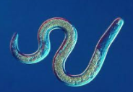
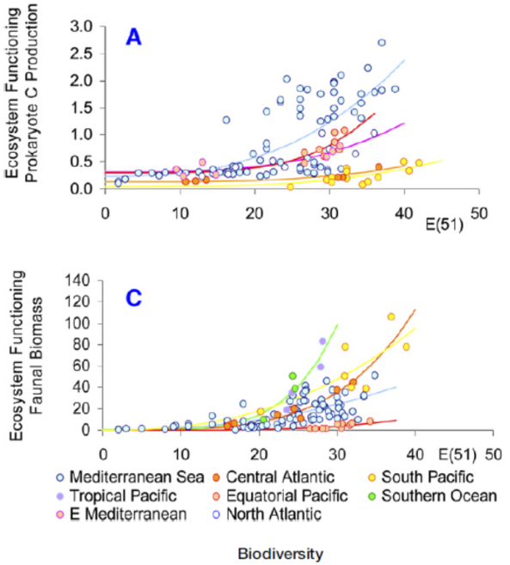
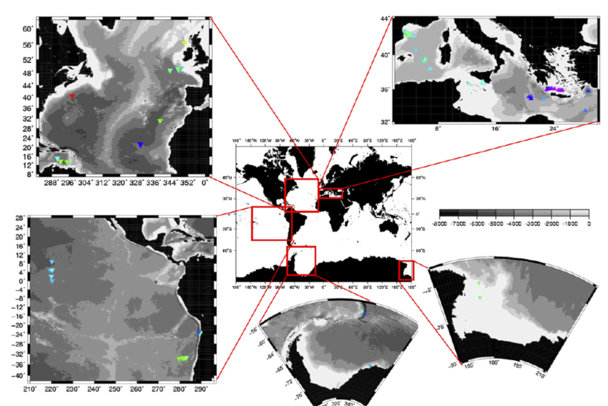
So how is the relationship between functioning and biodiversity in nature?
Deep sea nematodes
(Danovaro et al. Current Biology 2008)

Slide 15
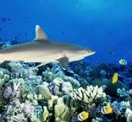
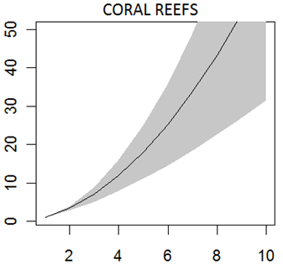
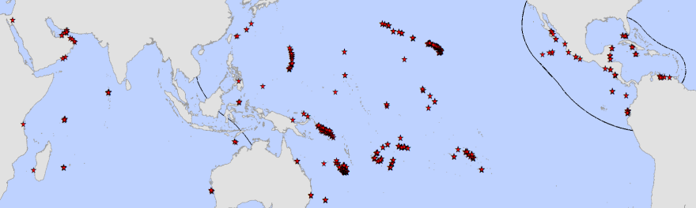
So how is the relationship between functioning and biodiversity in nature?
Coral reef fishes
(Mora et al. Plosiology 2011)
Biomass production
Species richness

Slide 16
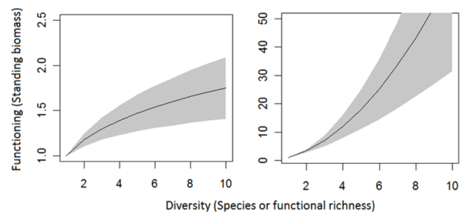
Why are relationships between functioning and biodiversity different in experiments and nature?
Experiments
Nature

Slide 17
Why are relationships between functioning and biodiversity different in experiments and nature?
Experiments
Nature
Niche specialization
Experiments
Nature
Production
Experiments

Slide 18
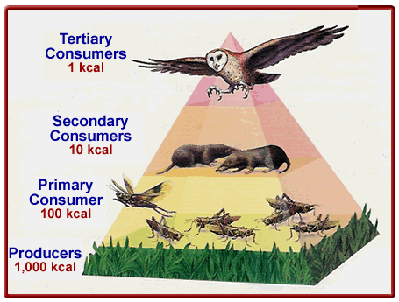
Why are relationships between functioning and biodiversity different in experiments and nature?
Experiments
Nature
So the increase in production is simply an ecological release
Trophic extinction
x
Lower trophic levels increase their biomass

Slide 19
Implications
Many species are necessary to maintain the functioning of an ecosystems
Experiments
Nature
There is redundancy
The lost of each species could have irreplaceable effects
We may afford to lose few species without any major effect on ecosystem functioning
There is not redundancy
For every species that is lost, we cause an exponential lost of ecosystem functioning
Few species could maintain the functioning of an ecosystems

Slide 20
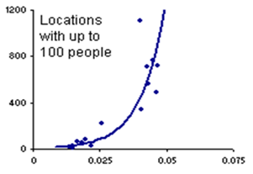
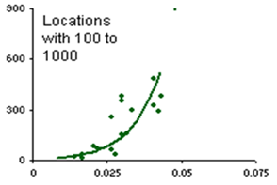
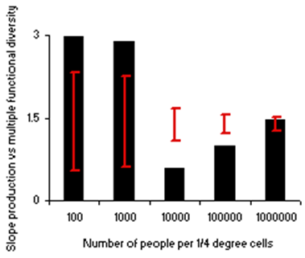
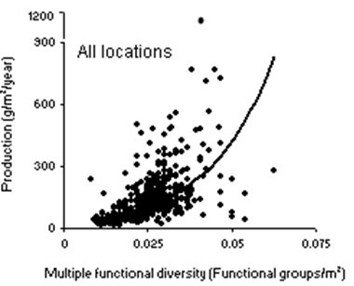
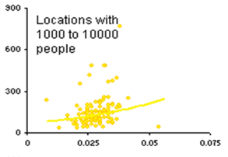
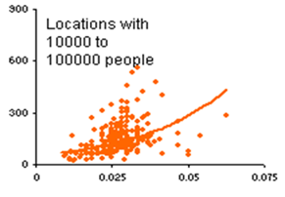
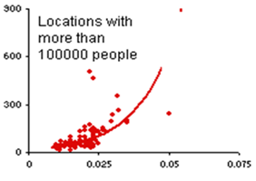
So what factors affect the relationship between functioning and biodiversity in nature?
No much is known as the study of such relationship in nature is rather recent
However,

Slide 21
Humans influence the biodiversity-productivity relationship in reef fishes but why?
Humans reduce their use of reef resources
Reefs fish communities re-assemble to human pressure

Slide 22
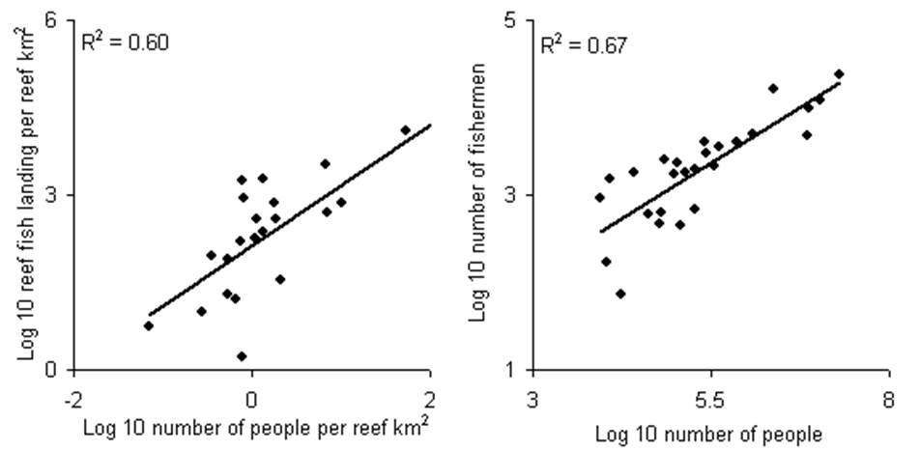
Humans reduce their use of reef resources:
Not really!

Slide 23
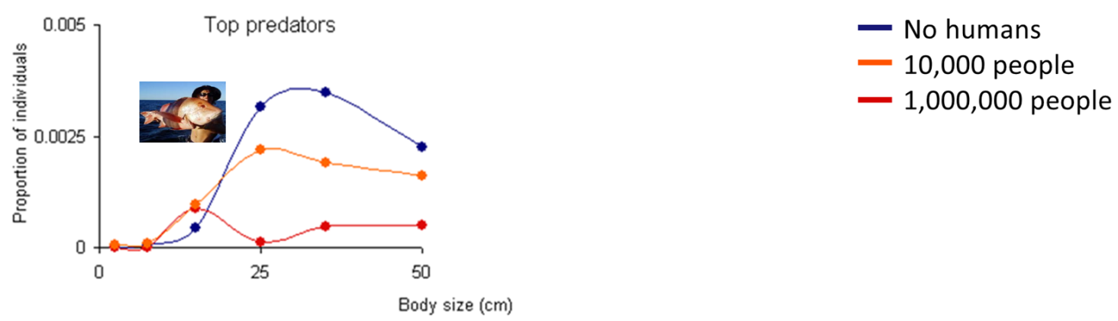
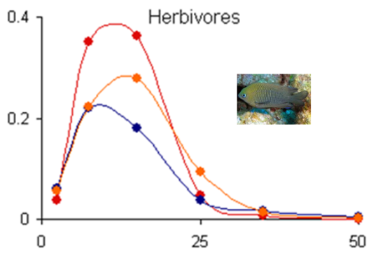

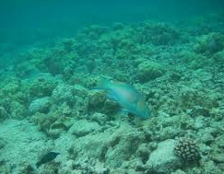
Reef fish communities re-assemble to human pressure
More top predators
Less top predators
More herbivores
Human population appear to induce trophic changes in reef fish communities, which in turn lead to significant changes in ecosystem functioning

Slide 24
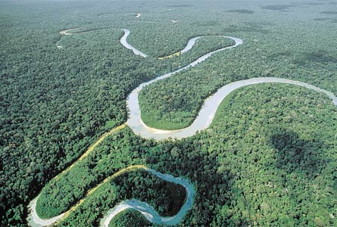
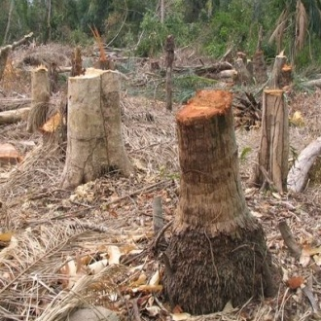
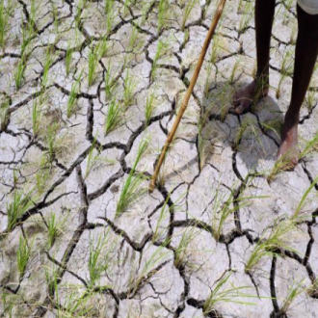
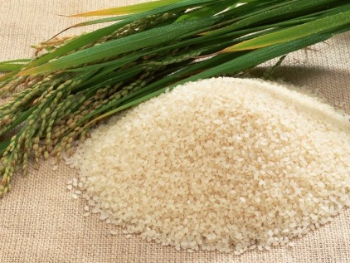
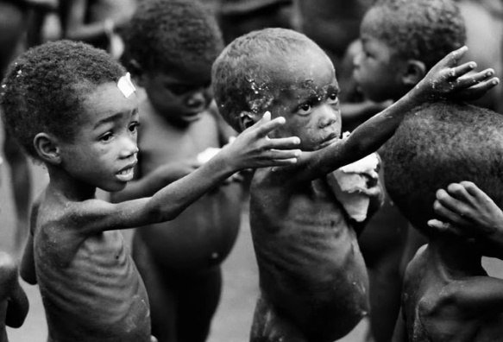
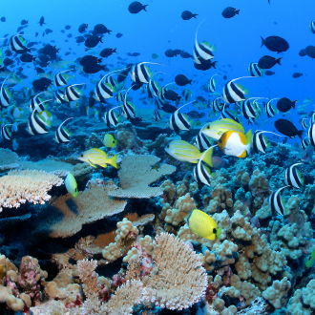
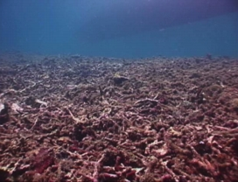

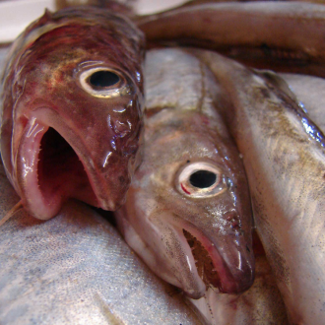
Why is it important to study the relationship between biodiversity and ecosystem function?
Loss of goods and services
Loss of human welfare
~1 billion people is hungry each day (“FAO, The State of Food Insecurity in the World, 2008 ).
This is one billion people for which their nearby environment does not supply enough food already.
Ecosystem functions are the same as those that deliver nature’s good and services to humanity
A person dies every second as a direct or indirect result of poor nutrition
(“The right to food : Commission on Human Rights resolution 2002/25”).
A child under five dies every five seconds as a direct or indirect result of poor nutrition
(“The State of Food Insecurity in the World, 2002).

Slide 25
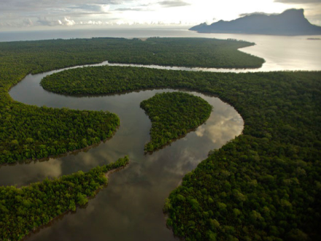
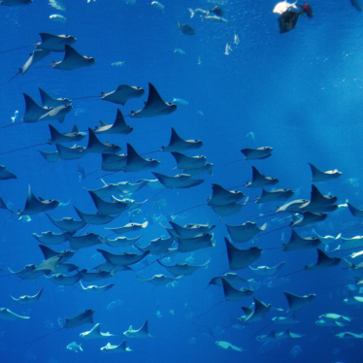







Economic value
Air
Water
US$33 trillion per year
(Constanza et al., Nature 1997)
Food
Recreation
Medicine
Notes:
In contrast to the loneliness of the universe, we share this planet with over 8.7 million species. These species are key to the air we breath, the water we drink and the food we eat….and a long list of good and services to humanity.
If we consider that our own welfare depends on biodiversity and that there is not another planet we can do our experiments in, then it does not make any sense for us to be tampering with basic planetary functions. We are simply playing with fire.

Slide 26
Summary
History of colonization
What factors
Influence such relationship
Human population
What factors
Influence such relationship
Habitat heterogeneity
Disturbances
Nature
Ecological interactions
Functioning
(Productivity)
Experiments
Richness
Complementarity
Why
Sampling effect
Production of goods and services
Human welfare

